Slide 2

Mental Health; the impact of COVID-19
on the well-being of children, especially those
with special needs and disabilities.
Professor Barry Carpenter, CBE, PhD, FCCT
Professor of Mental Health in Education, Oxford Brookes University
UK

Slide 3
This presentation is based on the Think Piece -
A Recovery Curriculum: Loss and Life for our children and schools post pandemic
Barry Carpenter, CBE, Professor of Mental Health in Education, Oxford Brookes University.
Matthew Carpenter, Principal, Baxter College, Kidderminster, Worcestershire.
See further – http:// www.recoverycurriculum.org

Slide 4

Scarlett, (who is 8 years old) said, through her tears...
“This virus is stealing my life from me!”
As her Dad, that was hard to hear.
Quote from a parent, January 2021.

Slide 5
Being positive for parents
“Knowing how to home school is not something parents are
born knowing. ….. it can be a minefield to know what to do for the best.”
Laura Purser (2021)
Parenting in a Pandemic; A Little Guide for Parents.
“Confident Championing offers a model that explains the dynamic nature of the adjustment process (to parenting a child with disabilities), capturing both the stress, the fulfilment and sense of purpose that
parents experience.” ‘Connor, A., Carpenter, B.,Coughlan, B. (2021)
British Journal of Learning Disabilities
Articles available on www.barrycarpentereducation.com

Slide 6
"Child development does not stop in a crisis.
The foundations of lifelong learning, health, and behaviour are being laid now …
These foundations will be as strong – or as weak – as the relationships and experiences children find themselves in during this time.
… Now is our time to do things differently.”
Hannah Barber, (December, 2020)
Center for the Developing Child, USA

Slide 7
The Recovery Curriculum
a construct
built on compassionate leadership
a culture of kindness
best informed judgements
a personalised response
www.recoverycurriculum.org

Slide 8
Compassionate leadership …
… will be key to this process and to re-establishing the well-being of the whole school community. Kindness matters too. At a time when the future is uncertain and we feel disconnected, our mental health and well-being frail and fragile, the smallest act of kindness can have the biggest effect.
Carpenter, B. (2021 – in press)
“From Recovery to Resilience” In Tutt, R. & Williams, P. ‘How to Maximise Emotional Wellbeing and Improve Mental Health; the essential guide to establishing a whole school ethos.’
London: Routledge

Slide 9
5 Losses and Ofsted Report
Outcomes (November 2020)
of Routine … regression eg toilet training.
of Structure … pencil grip, holding a knife and fork.
of Friendship … loss of social interaction; children playing in silence.
of Opportunity … mental distress; self harm/eating disorders.
of Freedom … loss of stamina and of physical fitness.

Slide 10

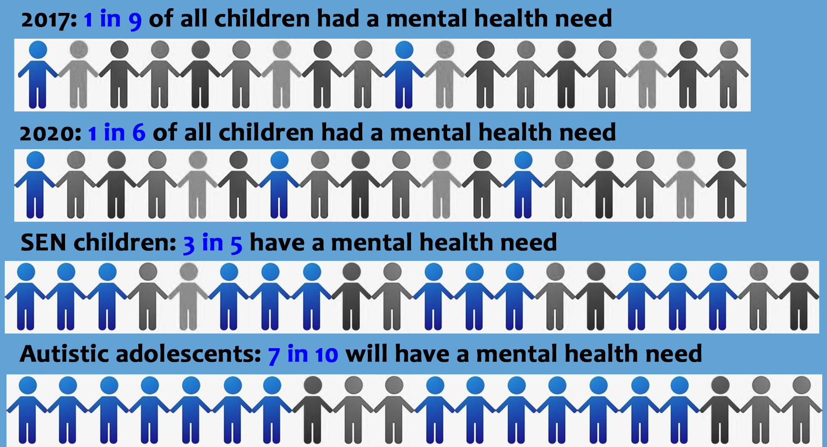

Slide 11
What did we do?
Parent and child report online surveys at three different timepoints:
Timepoint 1:
Before & During Lockdown
Timepoint 2:
Just before the return to school
Timepoint 3:
>6 weeks after schools reopened
Milner, V. (2021- in preparation) (MENtal health and eDucation in
Autism (MEND-A): A look at the impact of the COVID-19 school
changes on autistic children’s mental wellbeing.
Kings College, London
Notes:
June 7th – 30th July: in the midst of lockdown just before the start of the summer holidays we asked participants to comment on emotional wellbeing before and during the pandemic
18th Aug – 24th Sept: at the end of the summer holidays and at the very start of the autumn term we asked participants to comment on emotional wellbeing just before all students were allowed to return to school
11th Nov – 31st Dec: at the middle/end of autumn term we asked participants to comment on wellbeing after all students have been allowed to return to school
Comment – when we originally designed the study we believed that T3 would be return to normality… therefore there is scope to complete a time point later this year hopefully to see the effects.
Parent survey
Questions about the parent included location, educational attainment, relationship to the child, household characteristics, whether anyone in the household had tested positive for COVID. Questions about the child included gender, date of birth, ethnicity, ASD diagnostic status, information about who gave the Dx, age of Dx, and additional diagnoses. Questions about the child’s school included school year group, type of schooling, duration of attendance, EHCP status, lockdown attendance, schoolwork completion during lockdown, # of hours spend on schoolwork during lockdown, burden of schoolwork on parent, online schooling and extra support.
Child survey
Questions about the child included gender and date of birth. Questions about the child’s school included school year group, type of schooling, duration of attendance, lockdown attendance, schoolwork completion during lockdown, # of hours spend on schoolwork during lockdown, online schooling and extra support.

Slide 12
What did we do?
Demographics
Child – age, diagnosis/es, gender
Child school – year group, type of schooling, EHCP status, lockdown attendance, # hours spend on schoolwork during lockdown, extra support
Bespoke wellbeing questions
Anxiety, Mood, Sleep, Eating behaviour, Social Interaction, Emotional Outbursts, RRBIs, Tolerance of uncertainty, Screen time, Engagement with school work, Family life
Open text questions
Advantages/disadvantages of lockdown on educational experience
Other factors impacting wellbeing
Standardised Questionnaires
Strengths and Difficulties Questionnaire (SDQ)
Revised Children’s Anxiety and Depression Scale (RCADS)
Intolerance of Uncertainty Scale (IUS)
Emotional Dysregulation Index (EDI) (PARENT ONLY)
Pre-lockdown difficulties in school
School changes that occurred during lockdown they hope will remain
Parent – location, educational attainment, relationship to child, household characteristics
Notes:
Parent survey
Questions about the parent included location, educational attainment, relationship to the child, household characteristics, whether anyone in the household had tested positive for COVID. Questions about the child included gender, date of birth, ethnicity, ASD diagnostic status, information about who gave the Dx, age of Dx, and additional diagnoses. Questions about the child’s school included school year group, type of schooling, duration of attendance, EHCP status, lockdown attendance, schoolwork completion during lockdown, # of hours spend on schoolwork during lockdown, burden of schoolwork on parent, online schooling and extra support.
Child survey
Questions about the child included gender and date of birth. Questions about the child’s school included school year group, type of schooling, duration of attendance, lockdown attendance, schoolwork completion during lockdown, # of hours spend on schoolwork during lockdown, online schooling and extra support.

Slide 13
Our Sample
Timepoint 1
7th June – 30th July 2020
Timepoint 2
18th August – 24th September 2020
Sample = 48 parents (58% had a child with an autism diagnosis, 48% male), 16 children (56% had autism dx, 50% male)
Timepoint 3
11th November – 31st December 2020
Sample = 47 parents (56% had a child with autism diagnosis, 46% male), 16 children (44% had autism dx, 62% male)
Sample = 73 parents (60% had a children with an autism diagnosis, 52% male child), 35 children (57% had autism dx, 54% male)
Notes:
28 ASD, 2 seeking diagnosis, 17 not autistic
6 of ASD group attended school throughout, 1 non autistic attended school.

Slide 14
DURING COVID-19, overall, how have the changes to school affected your child’s emotional and mental wellbeing?
Thriving
Reduced anxiety and more relaxed
Enjoying the increased choice and flexibility in learning
Less pressure and exam stress
Less social pressure
Struggling
Worsened mental health (anxiety, emotional outbursts, low mood)
Difficulties adapting to online/home learning
Lack of structure/routine
Limited peer interaction may worsen social skills
No transition support
He loves not having to go in to school and has said he enjoys subjects he did not before as he can do the work when it suits him without having to sit in lessons.
While he struggles with school and always found it his stressful place, with home his safe place - the closure of school meant he had no place that he felt safe. Home became school.
She has not understood everything and felt as if she was getting behind which made her worry.

Slide 15
“During the pandemic Autistic people have been traumatised in ways that neuro-typical people have not.
Many have PTSD, which is not being detected by current assessments.”
Professor Francesca Happe
September 2020.

Slide 16

By 2020 depression will be the most prevalent childhood disorder
Pretis and Dimova (2008)
The global pandemic has robbed many children of hope, which is a gift of childhood.
Carpenter, B and Carpenter, M. (2021)

Slide 17
The Children’s Commissioner called for:
Investment in children’s mental health
Commitment to provide technology for remote learning
A focus on vulnerable teenagers at risk of never returning to schools
Work to bridge the gaping inequalities the pandemic has exposed
September, 2020

Slide 18
“A matter of national concern”
"The invisibility of vulnerable children as a result of the pandemic should be a matter of national concern … with many vulnerable pupils still not back in the classroom, child protection referrals down and fears that abuse may be going undetected.”
Amanda Spielman, December 2020
Ofsted Chief Inspector of Schools.

Slide 19
The continuum of vulnerability
Disadvantage
Deprivation
Disability
V U L N E R A B I L I T Y
Notes:
The continuum of vulnerability. These statistics, these effects, these factors generate what I would term the ‘continuum of vulnerability’ in our children and young people. The children can fall anywhere on this continuum due to disadvantage, economic or social deprivation (particularly poverty is known to have a severe effect on the emotional wellbeing and self-esteem of children) or indeed disability. We have to remind ourselves that 20% of our child population in any school is likely to have a special educational need some of which will arise from a disability. Hence our children are at risk. What are some of the risk factors affecting children?

Slide 20

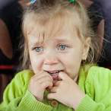
Vulnerable children…
...Fragile learners
© B Carpenter 2020

Slide 21
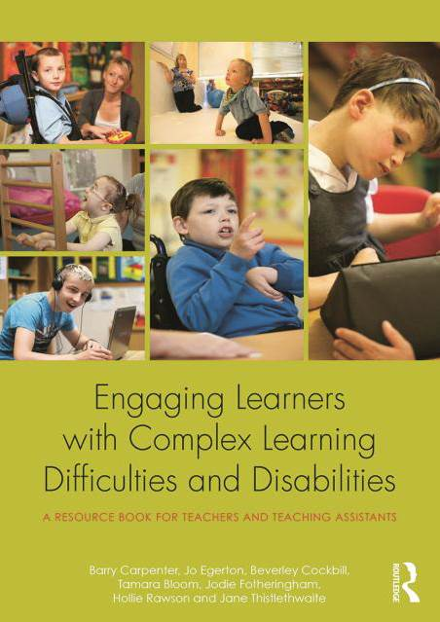
Mental Health IS A BARRIER TO LEARNING
www.routledge.com

Slide 22
Schools firefighting the
effects of Lockdown
Inspectors observed (Autumn 2020)
    regression
    in basic literacy and numeracy
    fine motor skills
    physical fitness
    language skills
    social interaction
    mental health
Issues were not about social disadvantage but parenting capacity.

Slide 23
“Rebuilding”
“Schools should make decisions based on the needs of each individual child.
Some children have lost a lot of time.”
Amanda Spielman,
Ofsted Chief Inspector of Schools.
BBC Radio 4 interview 6th July, 2020.

Slide 24

‘Education settings ….
……are critical to aid recovery from trauma.’
Professor Prathiba Chitsabesan, National Clinical Director for Children and Young People’s Mental Health. NHS

Slide 25
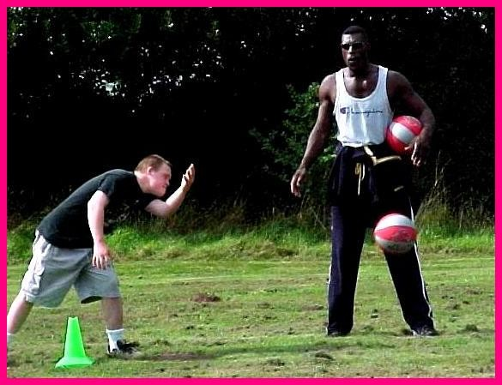
How do we keep our young people emotionally strong?

Slide 26
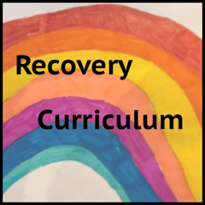
Phases of the Recovery Curriculum
  holistic recovery, for all
focussed recovery … a personalised, needs led approach
deep recovery - enabling a longer period of exploration of the trauma
www.recoverycurriculum.org

Slide 27
The 5 Levers
to a
Curriculum of Recovery
Lever 1: Relationships - Reach out to greet - don’t automatically expect them to return joyfully.
Lever 2: Community - Engage, listen, understand, grow together.
Lever 3: Metacognition - Explicitly scaffold teaching to grow confidence as a learner.
Lever 4: Transparent Curriculum - co-construct to show them how you are addressing the gaps.
Lever 5: Space - to be, to rediscover self-image, concept, esteem and confidence.
www.recoverycurriculum.org

Slide 28
More than ever…
“… we need a curriculum diet which revives, nourishes and sustains the child. If we fail to deliver this we will have some educationally malnourished children.”
Professor Barry Carpenter (2021 – in press)

Slide 29


Free download - www.booksbeyondwords.co.uk

Slide 30



Slide 31
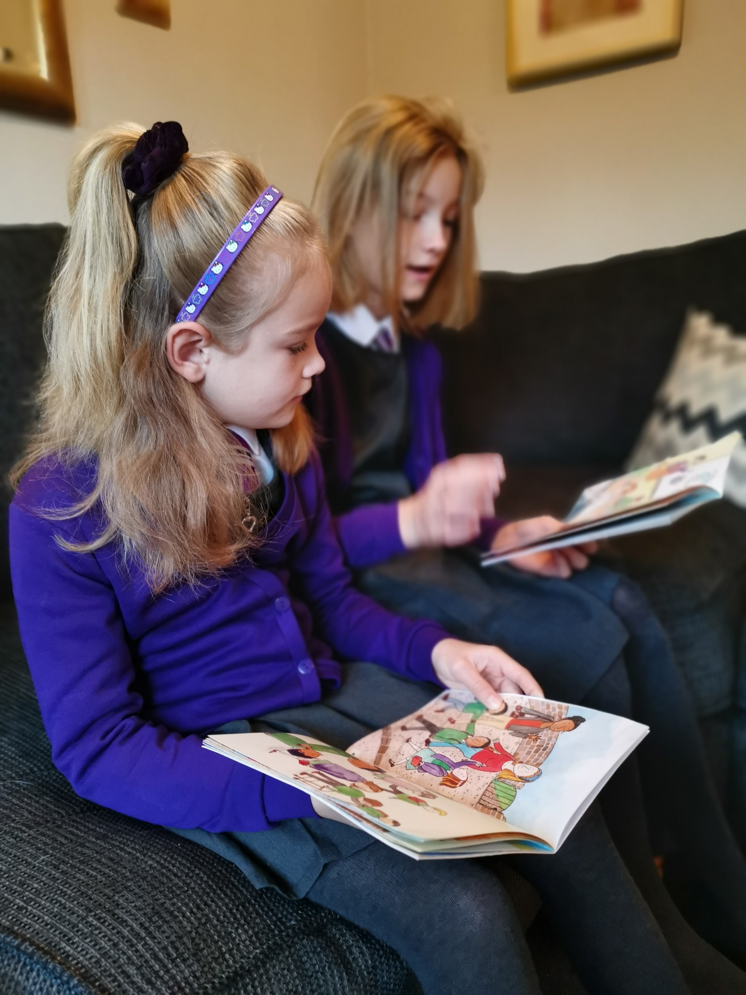
Sharing the ‘Lenny and Lily’ stories at Home

Slide 32
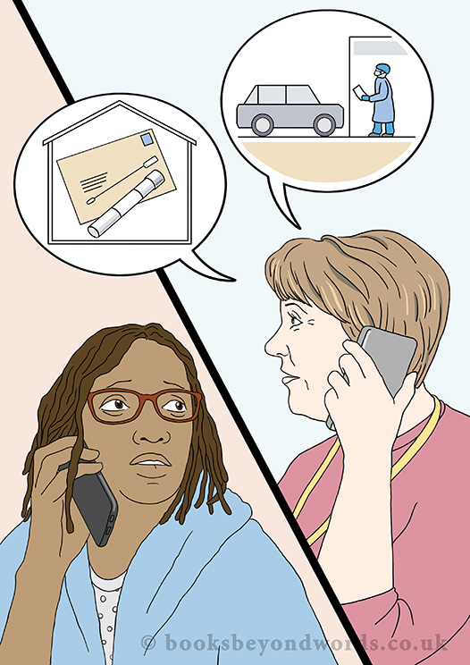
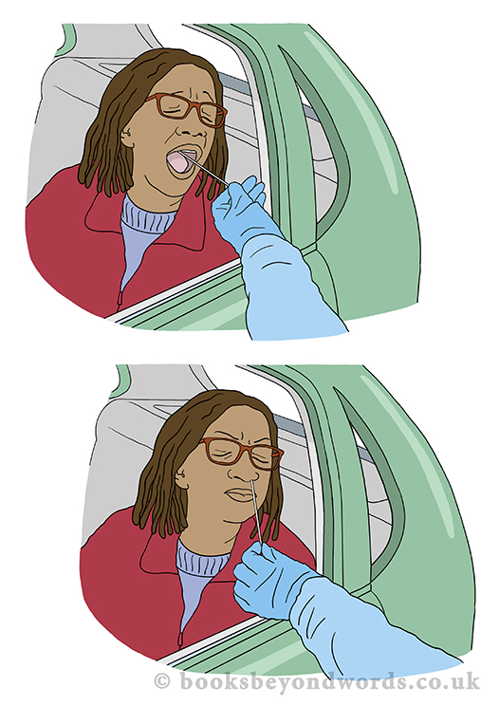
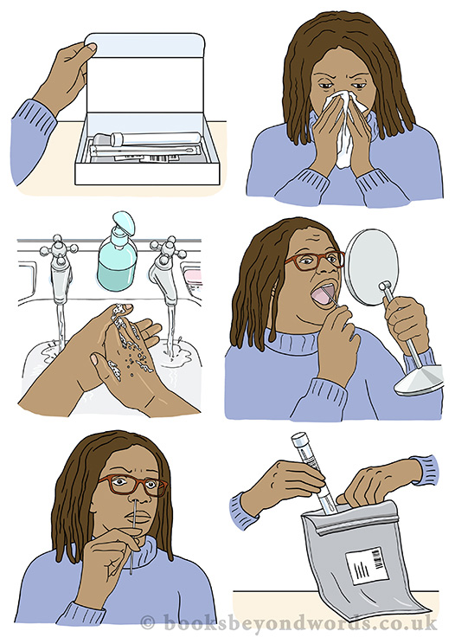

A wordless story about getting tested for coronavirus. The story shows how testing works at a drive through centre and using a self-test kit at home.
Free to download:
www.booksbeyondwords.co.uk/coping-with-coronavirus

Slide 33
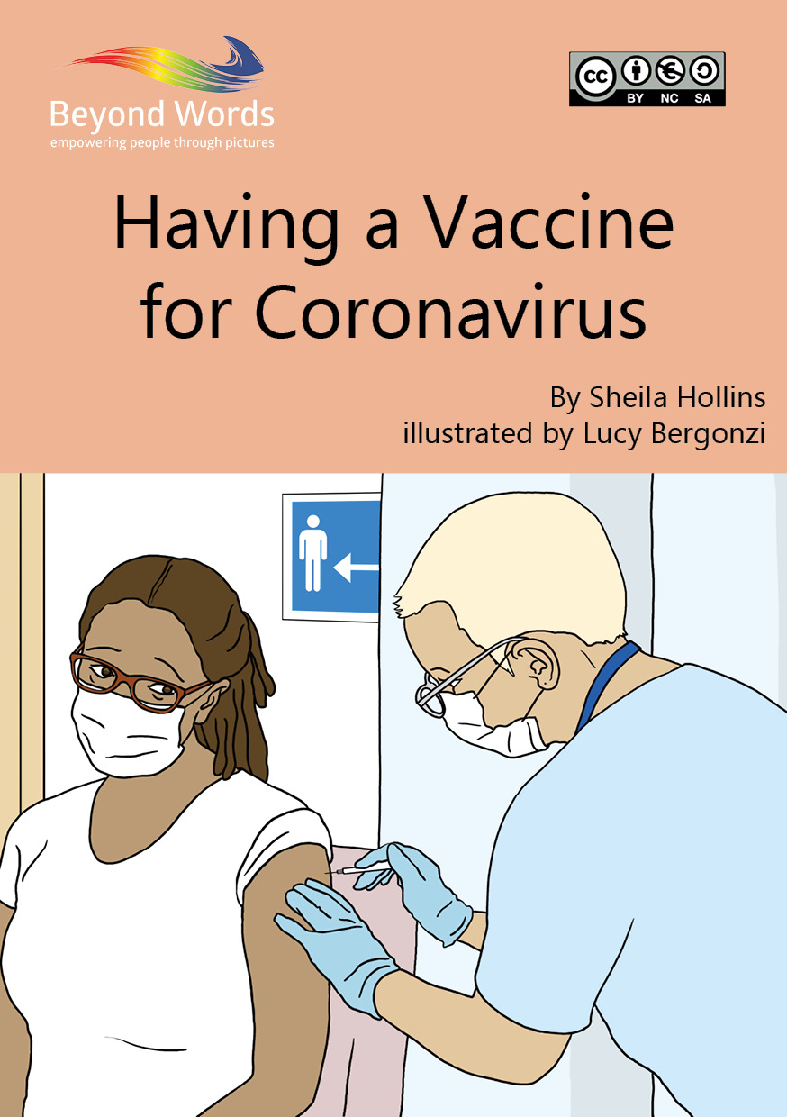
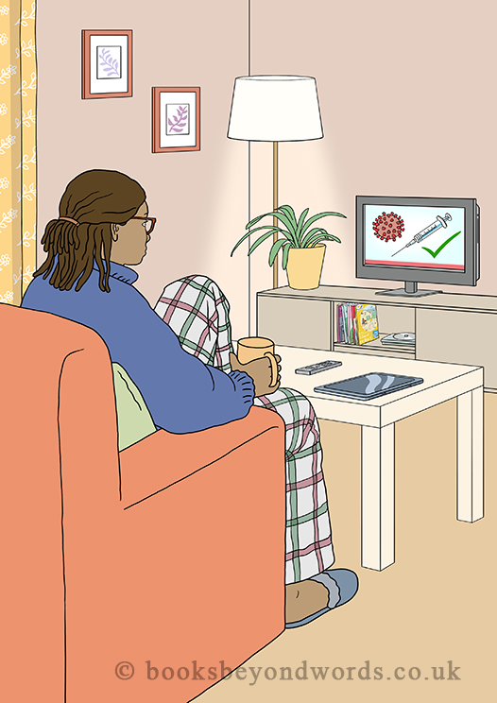
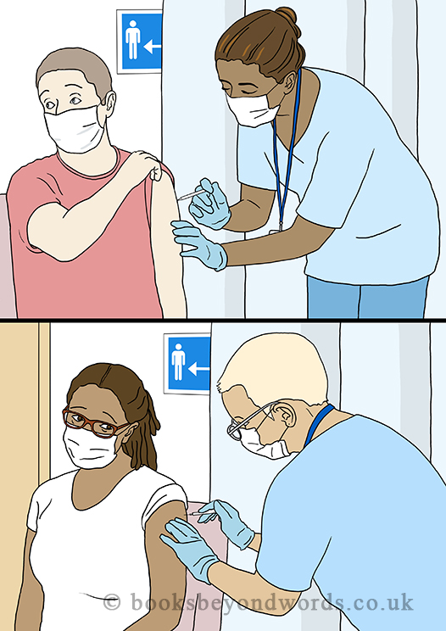
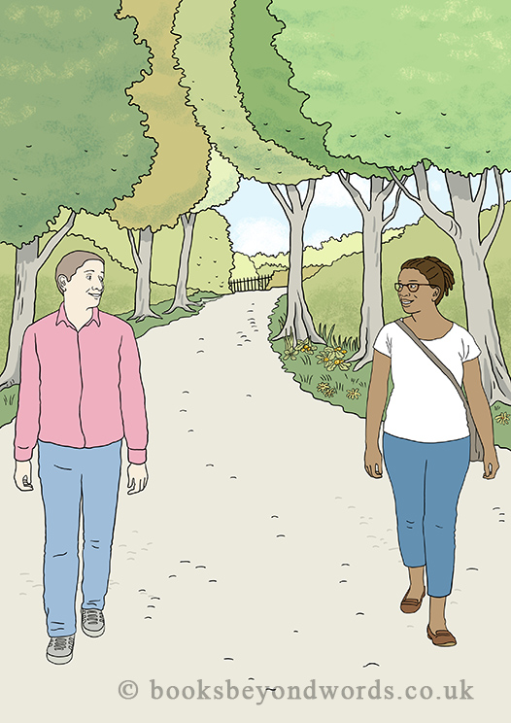
A wordless story from Beyond Words designed
to open up conversations around the coronavirus
vaccine.
The pictures can help people to ask questions and talk through their feelings and concerns with a supporter so that they feel prepared when they receive their invitation.
Free to download: www.booksbeyondwords.co.uk/coping-with-coronavirus

Slide 34
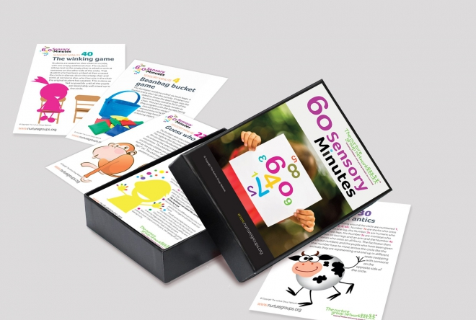
60 Sensory Minutes
Available from
www.nutureuk.org

Slide 35

Available from
www.nutureuk.org

Slide 36




Journals for Well Being
- from www.butterflyprint.co.uk
KS1-2
KS4-5
KS2-3
KS3-4
10% discount
Code: MH POST

Slide 37

From –
www.butterflyprint.co.uk

Slide 38
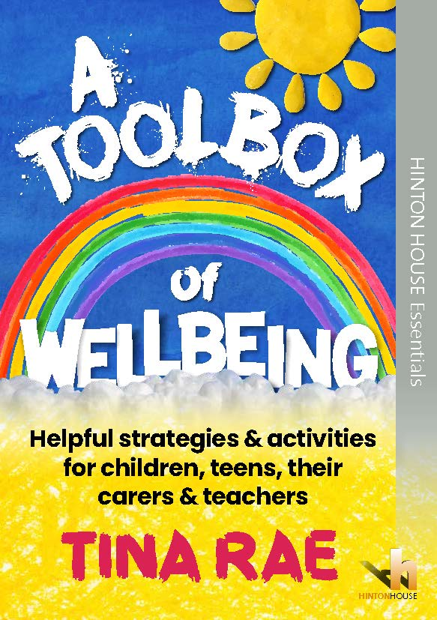
A must-have book full of easy to use activities to build emotional wellbeing in all children and young people and to support the Recovery Curriculum in schools.
Available from Hinton House publishers

Slide 39
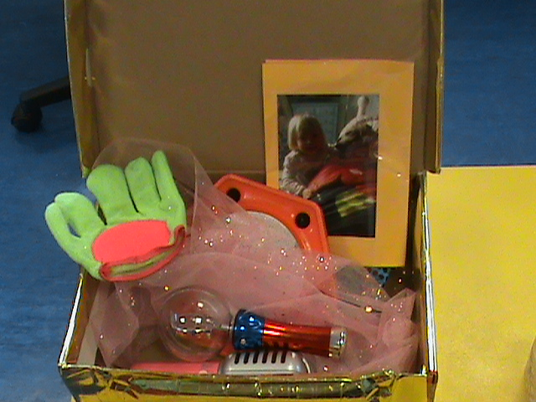
How do we engage the disengaged?
Happiness Box
https://barrycarpentereducation.com/2020/05/11/happiness-box/

Slide 40

The Engagement Model -
Learning Pathways
D
i
s
e
n
g
a
g
e
d
Intervention
E
n
g
a
g
e
d
Intervention
Intervention
Intervention

Slide 41
If children…
… see no relevance in the curriculum they are offered in this moment in time, they will reject it; their issues will be compounded, and their needs will go unmet.
More than ever we need compassion, kindness and creativity in teaching. We need bold teachers, ‘nimble leadership’, and a belief that education is the key.
Professor Barry Carpenter (2021 – in press)

Slide 42
Resilience-promoting aspects of education…
The School as a place
Education as a process
Educators as people
… and Teaching is a Relationship-based Profession

Slide 43

‘Many things can wait; the child cannot. Now is the time their bones are being formed and their mind is being developed. To them, we cannot say tomorrow; their name is today!’
Gabriela Mistral

Slide 44

Professor Barry Carpenter
International Educational Consultant
Contact details
www.barrycarpentereducation.com
www.engagement4learning.com
http://www.recoverycurriculum.org

